Slide 1


Pet feeder using IoT

Slide 2
Components
Power source(5 volt)
Servo motor sg90
LCD display 1602 module
Arduino nano
ESP8266 Wi-Fi module

Slide 3
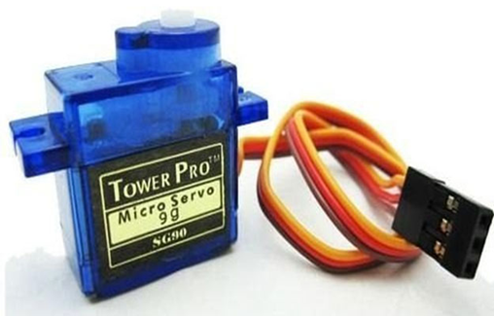
Servo Motor sg90
Operating Voltage is +5V typically
Torque: 2.5kg/cm
Operating speed is 0.1s/60°
Gear Type: Plastic
Rotation : 0°-180°
Weight of motor : 9gm
Wire Number | Wire Colour | Description
1 | Brown | Ground wire connected to the ground of system
2 | Red | Powers the motor typically +5V is used
3 | Orange | PWM signal is given in through this wire to drive the motor

Slide 4
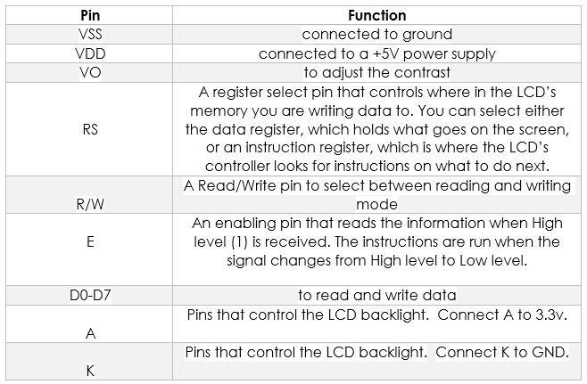
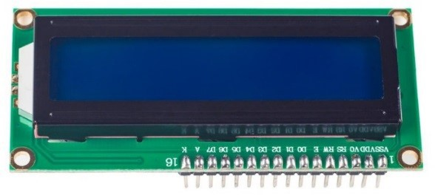
LCD Display 1602 Module

Slide 5
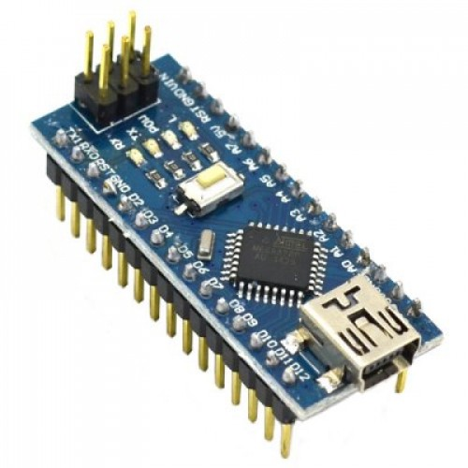
Arduino Nano
Microcontroller Atmel ATmega168 or ATmega328
Operating Voltage: (logic level) 5 V
Input Voltage: (recommended) 7-12 V
Input Voltage: (limits) 6-20 V
Digital I/O Pins: 14 (of which 6 provide PWM output)
Analog Input Pins: 8
DC Current per I/O Pin: 40 mA
Flash Memory: 16 KB (ATmega168) or 32 KB (ATmega328) of which 2 KB used by bootloader.
SRAM: 1 KB (ATmega168) or 2 KB (ATmega328)
EEPROM: 512 bytes (ATmega168) or 1 KB (ATmega328)
Clock Speed: 16 MHz
Dimensions: 0.73" x 1.70"

Slide 6
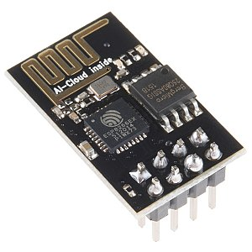
ESP8266 Wi-Fi Module
VCC, Voltage (+3.3 V; can handle up to 3.6 V)
GND, Ground (0 V)
RX, Receive data bit X
TX, Transmit data bit X
CH_PD, Chip power-down
RST, Reset
GPIO 0, General-purpose input/output No. 0
GPIO 2, General-purpose input/output No. 2

Slide 7
Advantages
It has two modes:
Automatic mode and Manual mode.
Automatic mode: As per the time programmed it operates automatically.
Manual mode: It can be controlled using phone via internet even from a long distance using the command “FEED”.
The mode can be toggled by using the commands “AUTO” and “MANUAL”.

Slide 8

Thank you!!

